Slide 1
TRUTH BE TOLD
Written and Directed by Nhlanhla Phewa

Slide 2
Song: “we are the little people who live in the temple of God. We have no sorrow. “
”

Slide 3
Today I am standing here, not as a politician or a poet. I am not a singer and I am not a pastor. So, who am I?
I am that voice that will always play in your mind. I am that child you call born free, but am I really free? Maybe apartheid times were better than this time and life we are living in. Maybe at that time people had a better understanding about life and what they need.
That time had Steve Biko, Walter Sisulu and the late Nelson Mandela who fought for freedom. Today there is no Steve Biko who will say “this is our country and HIV must go.” Today there is no one who will say “mayibuye I-Africa.”
Today we are dying because of HIV & AIDS. My brothers were not killed in apartheid but they were killed by HIV.
My younger sister was killed by HIV transmitted by a parent. Who is, really, HIV?
HIV is not a weapon but is a disease transferred during sexual activity. It’s that disease that killed my brothers and sisters. It’s that disease that makes me feel like crying or shouting when I think of it.
Where are today’s Steve Biko and Nelson Mandela who will change HIV from its own goals?
How many lives must HIV take before we take it seriously?
Oh yes. Today I am standing here to say HIV must fall.

Slide 4
Neli is home scrubbing the floor.
She asks her mother, Londiwe, about her father, who has long since deserted the family. This angers her mother and they argue.

Slide 5
Neli is crying from the argument. Her sister Nonto comforts her by singing a song.
The song is called Thula Thula Sana, and gives the sisters hope that their father can still come home.
Song: “Be quiet, be quiet my child”

Slide 6
Elsewhere, a man named Nkosinathi regrets having left his family and wonders how to return.
His friend Sanele convinces him to relax, enjoy life as it is, and go to a tavern with him for drinks.

Slide 7
Later that night, Mama Londiwe is fast asleep.
Neli, Nonto, and their sister Nokulunga convince their older brother, Siya, to take them to the tavern.
Song: “my baggage has become very heavy. Please help me carry it.”

Slide 8
At the tavern, Siya leaves his sisters. Sanele and Nkosinathi notice the girls and dance with them.
Nkosinathi soon leaves with Nokulunga, while Neli and Nonto stay and dance all night.

Slide 9
The next morning, Nokulunga wakes up in bed next to Nkosinathi. She doesn’t remember the night, but realizes they had unprotected sex.
Nkosinathi comforts her and they go back to sleep.

Slide 10
“My mom, today the truth should come out.
My mom, it’s been a while hiding it, but I don’t see it’s helping you.
I wish to know and find my rooms about my dad and myself.
Don’t cry.
Your tears are not going to help you each time I ask you.
You never come up with an answer
Tell me if he denied me… I will let my heart accept it.
My mom, please tell me who is really my father?
Fourteen years ago, who impregnated you?
I will love him.
Even if he is no good, I will hug him.
Even if he is an alcoholic, I will respect him.
Even if he is not working, I won’t be rude to him.
I will even warm his bath water if he comes home.
My mom, please tell me.
I would really like to know who is my father.
Who is this man who is not honest to stand for his actions and promises?
I might have been a disturbance in your love life, but I deserve to know.
My mom, please tell me, did he ask you to terminate your pregnancy?
But I don’t blame you if he said he loves you.
You wouldn’t know what was in his heart.
You won’t even tell the lies in his eyes.
Please, mom, tell me even if he’s a truck driver, I will love him.
I will love him if he tells me the truth why he left.
I will love him. “

Slide 11
At home, Mama Londiwe scolds Siya for leaving his sisters at the tavern the previous night.
.

Slide 12
A stranger with bags comes looking for Mama Londiwe. Upon seeing him, she becomes angry and tells Siya that the man is his father.

Slide 13
Meanwhile, the sisters sneak home and find Nkosinathi begging Mama Londiwe for forgiveness.
He then reveals that he is HIV positive.

Slide 14
Nokulunga realises with horror that the man from the previous night is her own father, and that she may have contracted HIV from him.
The tensions remain unresolved as she is comforted by her sisters’ singing.

Slide 15
Final songs:
“Things will be all right, Lord we thank you.”
“ Thank you Lord for the kindness, love and mercy you have shown us. We will always be thankful.”

Slide 16
Cast
Londi Seme
Sanele Chonco
Nkosinathi Mkhize
Siyabonga Xaba
Nelisiwe Ngubane
Nontokozo Maphumulo
Nokulunga Ndlovu

Slide 17
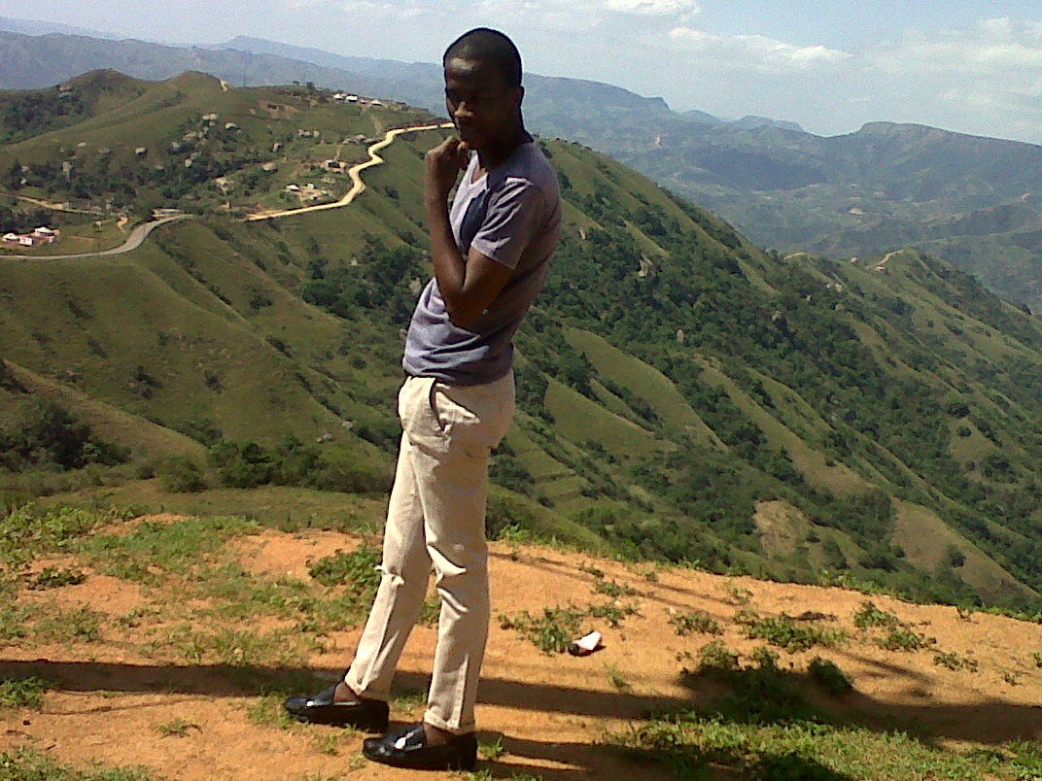
Written and Directed by Nhlanhla Phewa

